Slide 1
Predicting Retail Food Prices in Ugandan Markets Using WFP Market Price Data
Name: Florence Kemigisha
Course: Data Engineering and Analytics
Date: 13th August, 2026

Slide 2
Problem Statement
Food prices in Uganda change over time due to market conditions, seasonality, inflation, supply factors, and location differences. These changes affect household purchasing power and food security.
This project aims to build a machine learning regression model that predicts the next month retail food price of a commodity in the Ugandan market.

Slide 3
Data Description
Item | Value
Source | WFP Uganda Food Prices
Rows | 32,171
Columns | 16
Markets | 43
Commodities | 38
Period | Jan 2006 – Jun 2026
Currency | UGX
After cleaning the data set I stayed with 20,872 rows and 21 columns

Slide 4
Data Engineering Work Flow
Raw CSV
↓
Data Understanding
↓
Cleaning and Filtering
↓
Feature Engineering
↓
EDA and Visualization
↓
ML Preparation
↓
Model Training
↓
Evaluation
↓
Demo Interface

Slide 5
Data Cleaning and Preparation
Converted date to datetime
Converted prices to numeric
Removed non-food items
Kept retail prices only
Created year, month, quarter
Created previous_price
Created price_change
Created price_3_month_avg
Created price_6_month_avg
Created target variable next_month_price

Slide 6
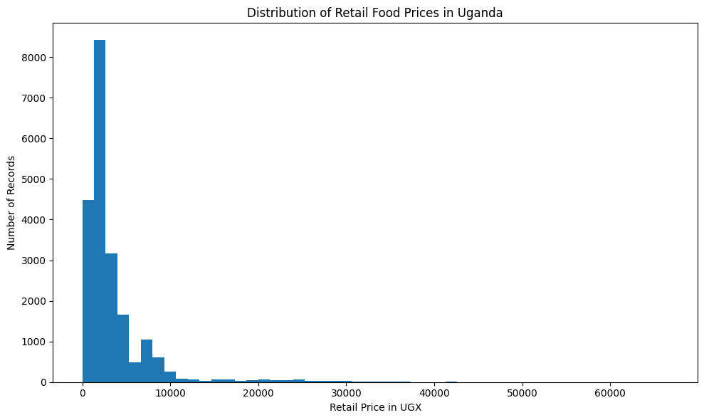
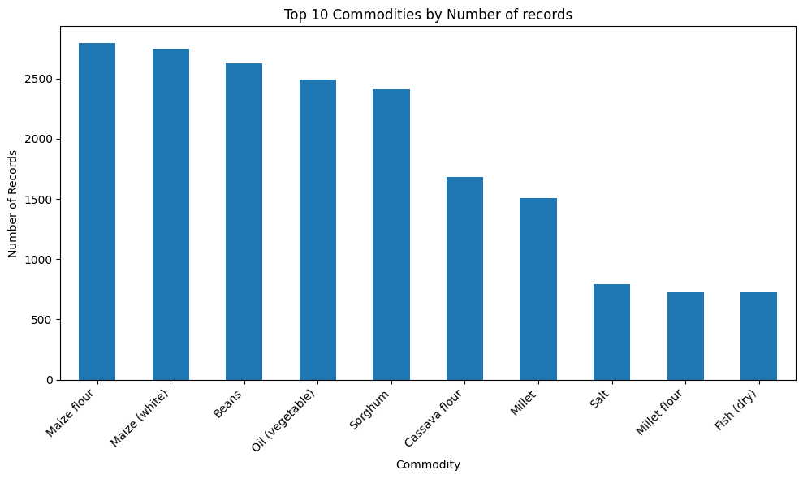
Exploratory Data Analysis

Slide 7
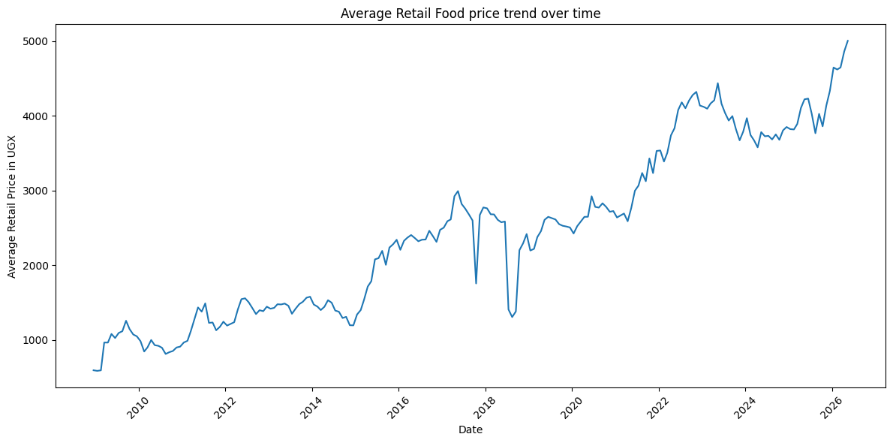
Exploratory Data Analysis showed that food prices vary by commodity, market, category, and time.

Slide 8
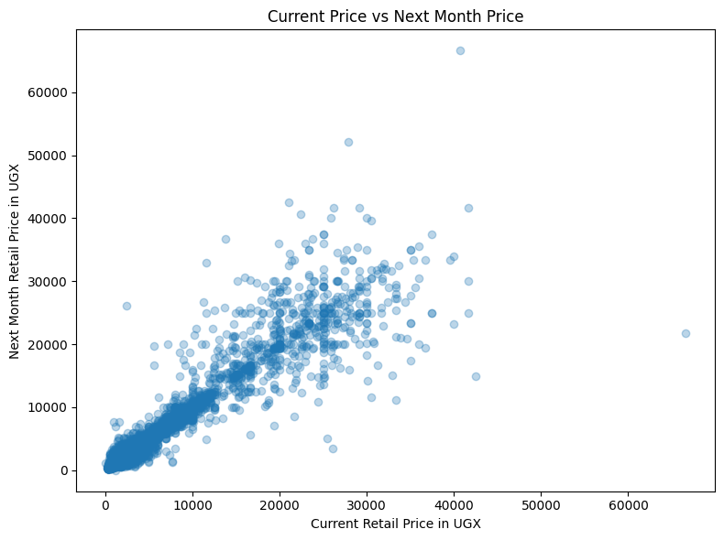
Relationship with target
The scatter plot showed a strong positive relationship between current price and next month price. This supports the use of regression because historical price values are useful predictors of future prices.

Slide 9
Machine Learning Models
Model | Purpose
Baseline | Assumes next month price equals current price
Random Forest Regressor | Classical ML model
Neural Network | Deep learning model

Slide 10
Model Evaluation
Model | MAE | RMSE | R²
Baseline | 557.70 | 1975.42 | 0.8586
Random Forest | 533.20 | 1697.70 | 0.8955
Neural Network | 691.14 | 1760.43 | 0.8877
The Random Forest model performed best because it had the lowest MAE, lowest RMSE, and highest R² score.

Slide 11
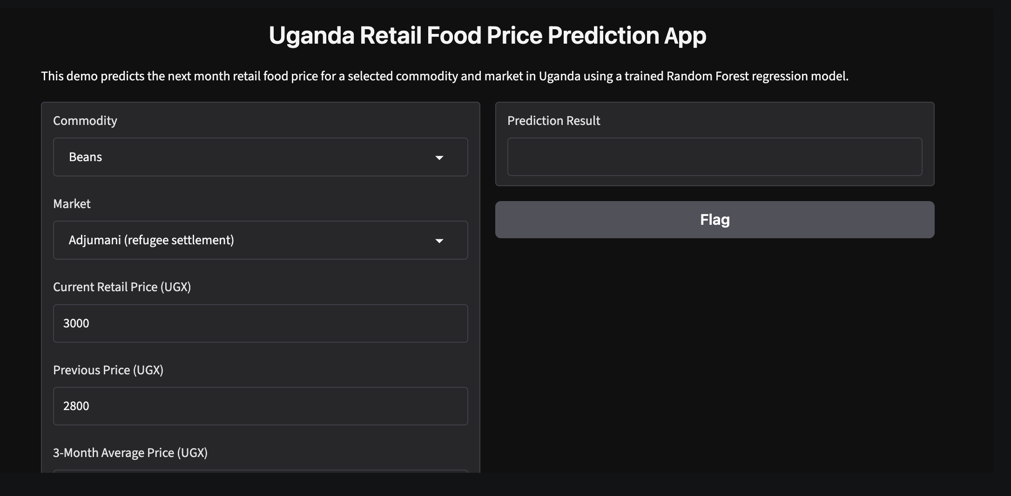
Demo Interface
The demo allows a user to select a commodity and market, enter price values, and predict the next month retail food price.

Slide 12
Limitations: The model does not include external factors such as rainfall, fuel prices, exchange rates, inflation, transport costs, harvest seasons, conflict, or supply disruptions. These factors may affect food prices and could improve future model performance.
Conclusion: This project successfully built an end-to-end machine learning pipeline for predicting retail food prices in Uganda.
The Random Forest model was selected as the final model, achieving an R² score of 0.8955. The project demonstrates data cleaning, feature engineering, visualization, classical machine learning, neural network modelling, evaluation, GitHub documentation, and a working demo interface.

